Slide 1
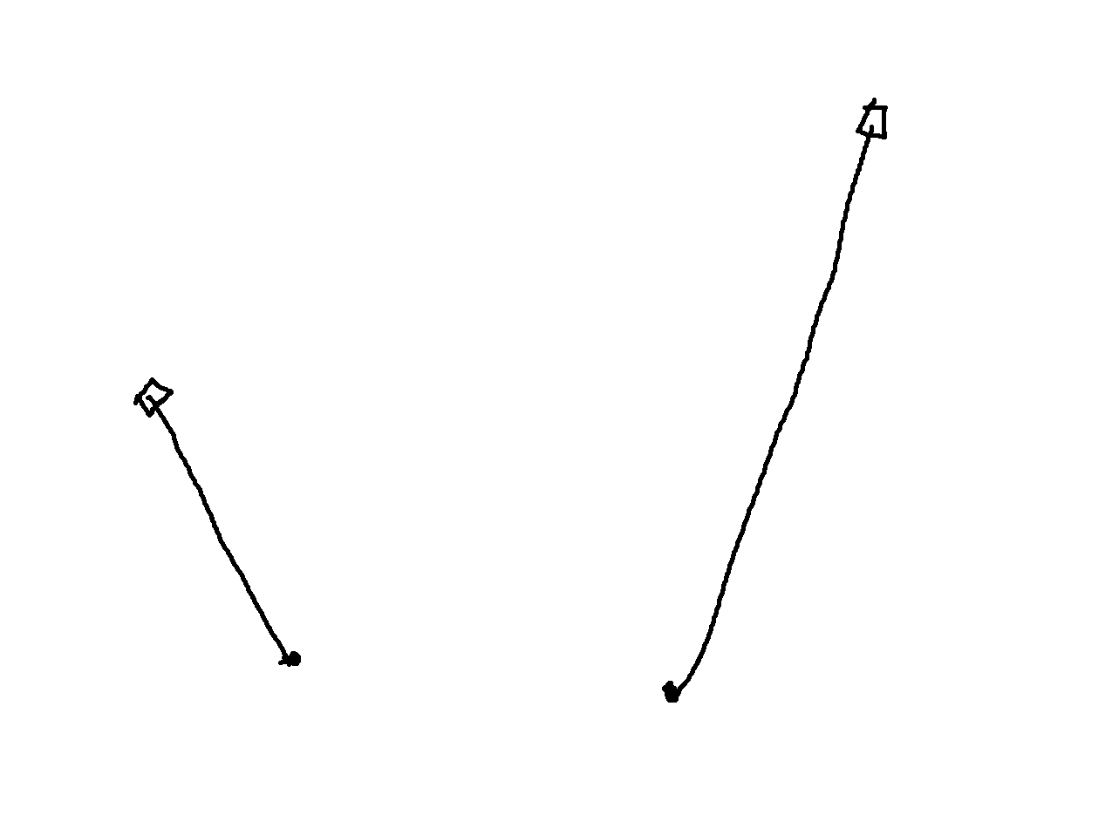
De Casteljau

Slide 2
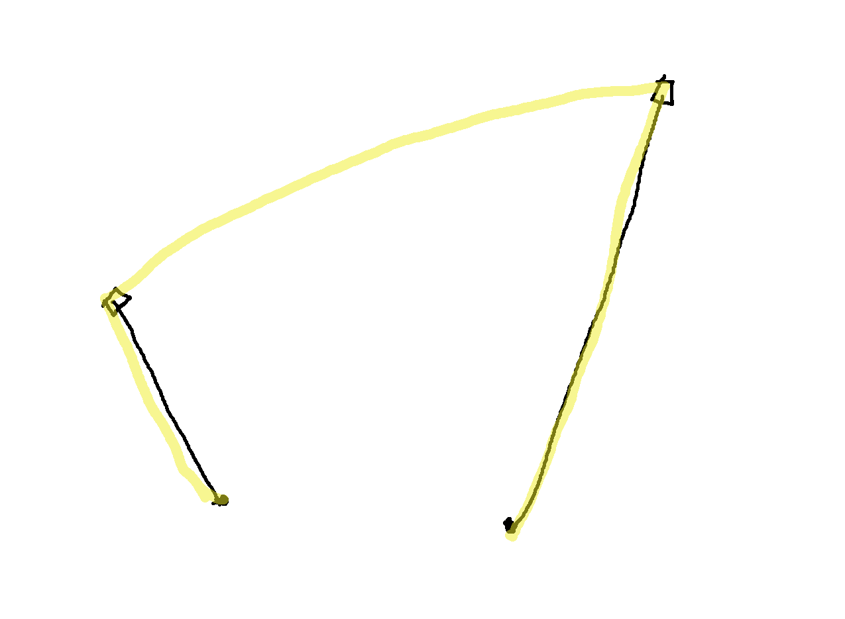
De Casteljau

Slide 3
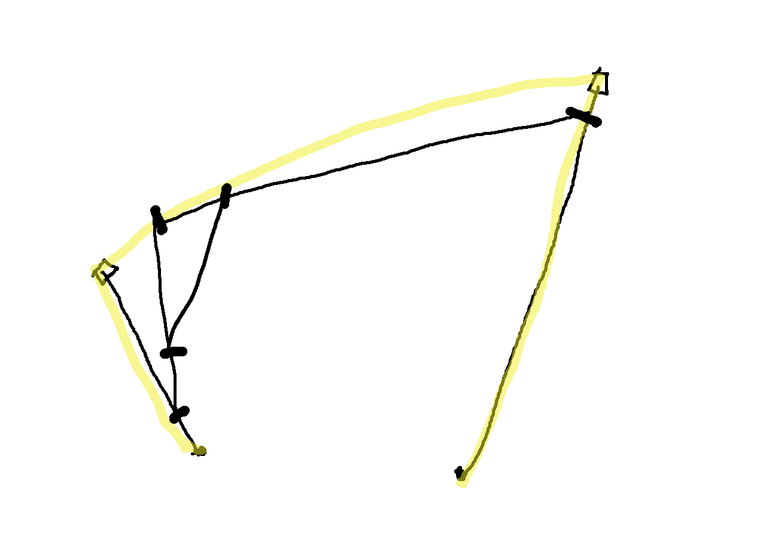
De Casteljau

Slide 4
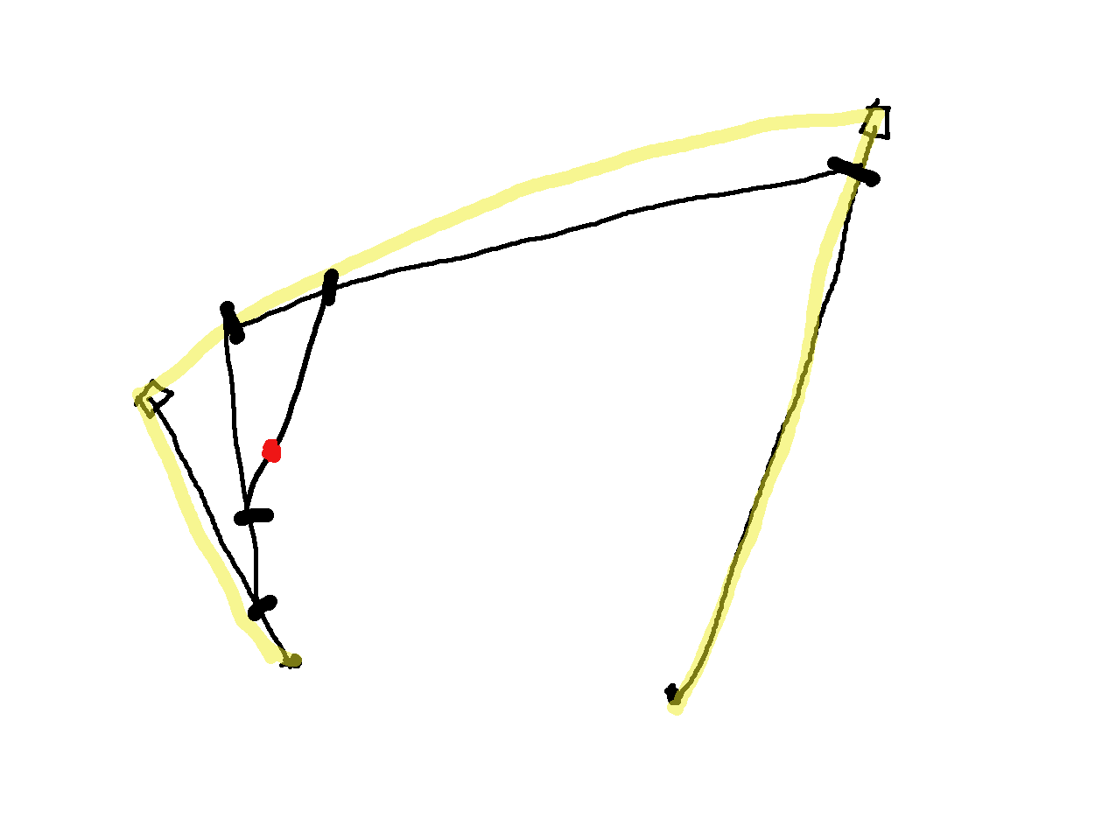
De Casteljau

Slide 5
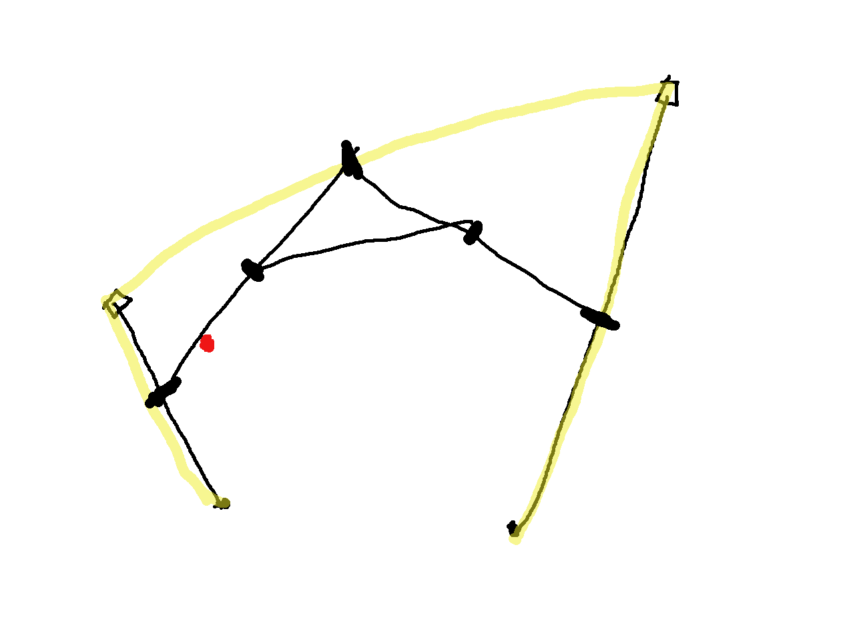
De Casteljau

Slide 6
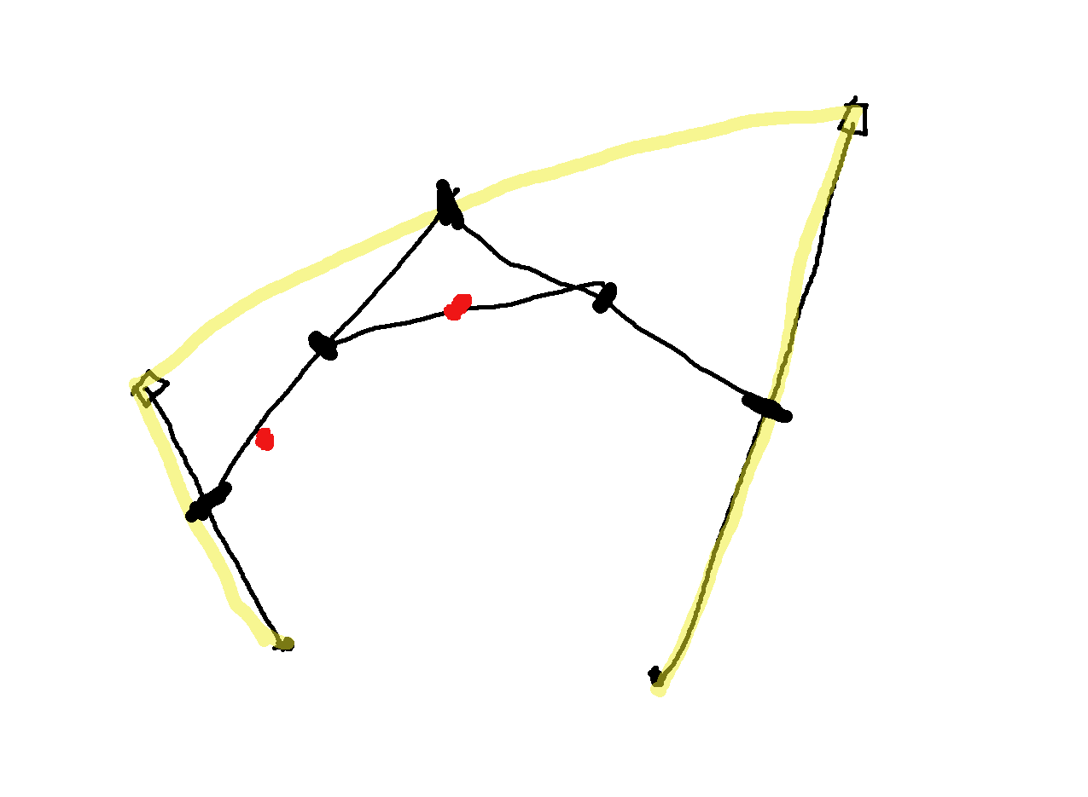
De Casteljau

Slide 7
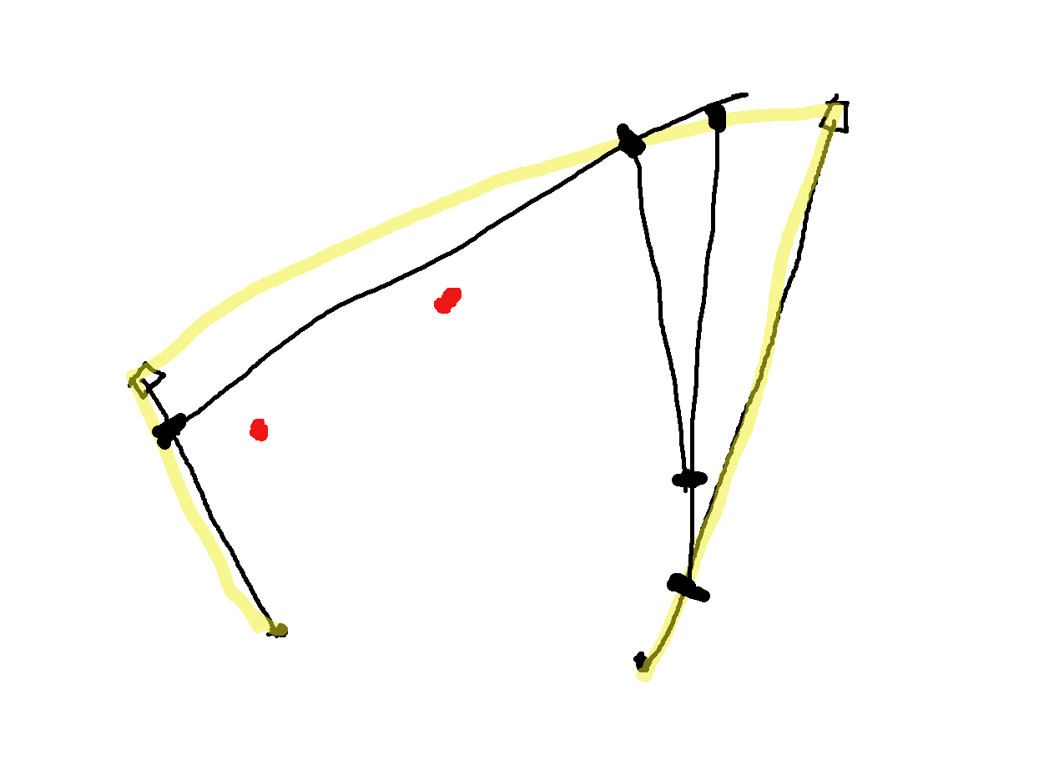
De Casteljau

Slide 8
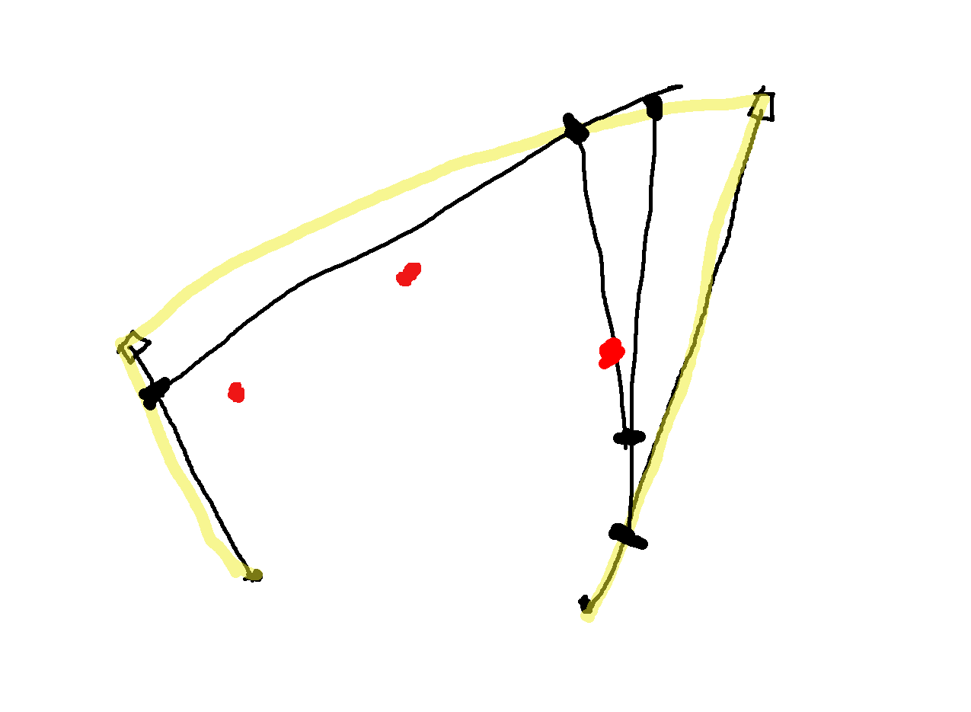
De Casteljau

Slide 9
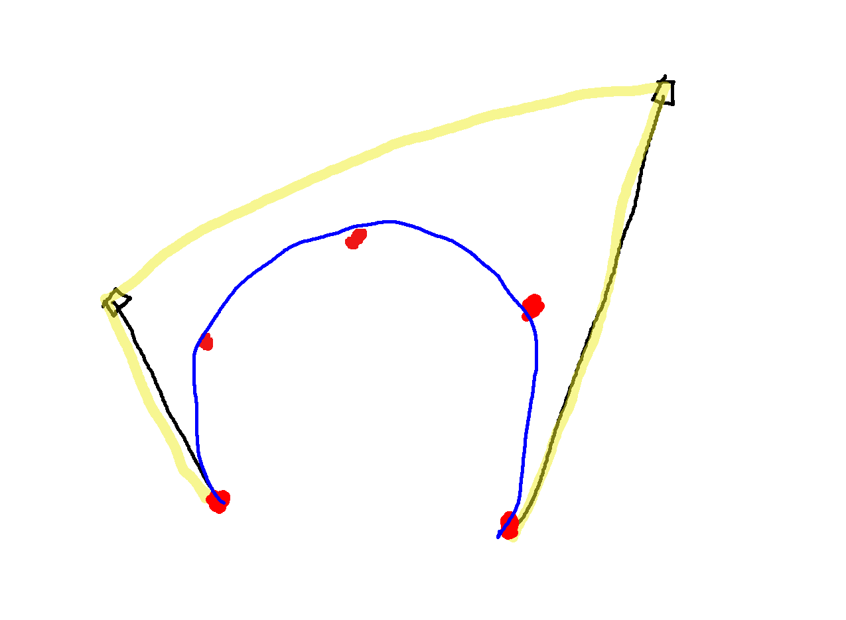
De Casteljau

Slide 10
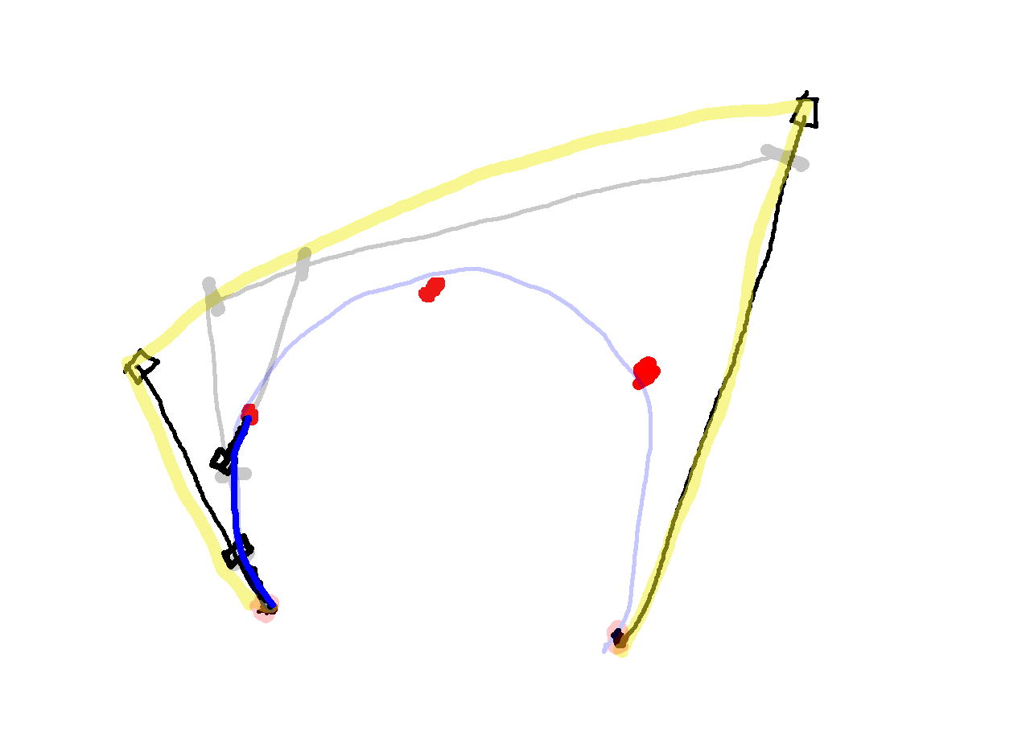
De Casteljau – splitting a Bèzier

Slide 11
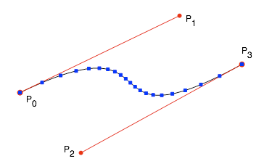
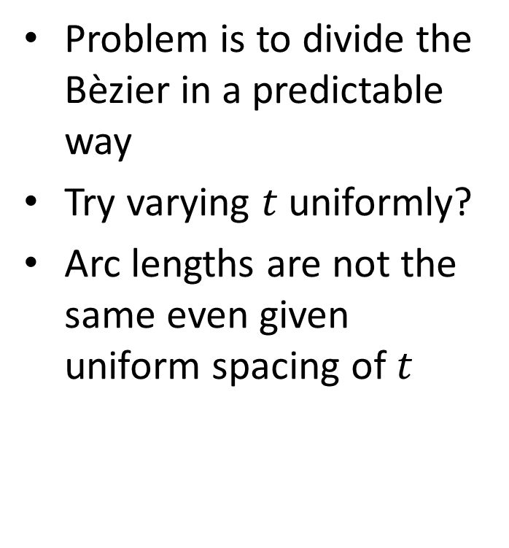
Bèzier arc length parameterization
Problem is to divide the Bèzier in a predictable way
Try varying $t$ uniformly?
Arc lengths are not the same even given uniform spacing of $t$
http://www.planetclegg.com/projects/WarpingTextToSplines.html

Slide 12
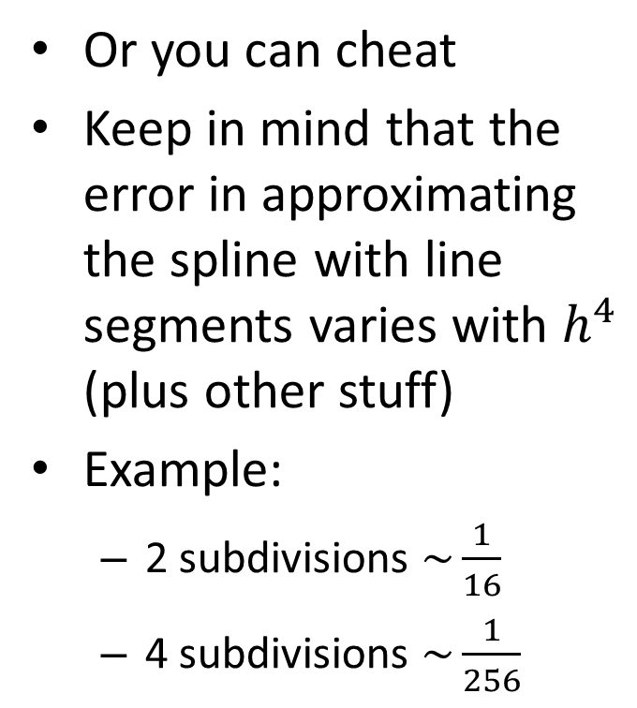
Arc length parameterization
Problem is to predictably subdivide the spline
It might be possible to do using standard integration
Or, it would be possible using numerical integration techniques
Or you can cheat
Keep in mind that the error in approximating the spline with line segments varies with $h^{4}$ (plus other stuff)
Example:
2 subdivisions $\sim \frac{1}{16}$
4 subdivisions $\sim \frac{1}{256}$

Slide 13
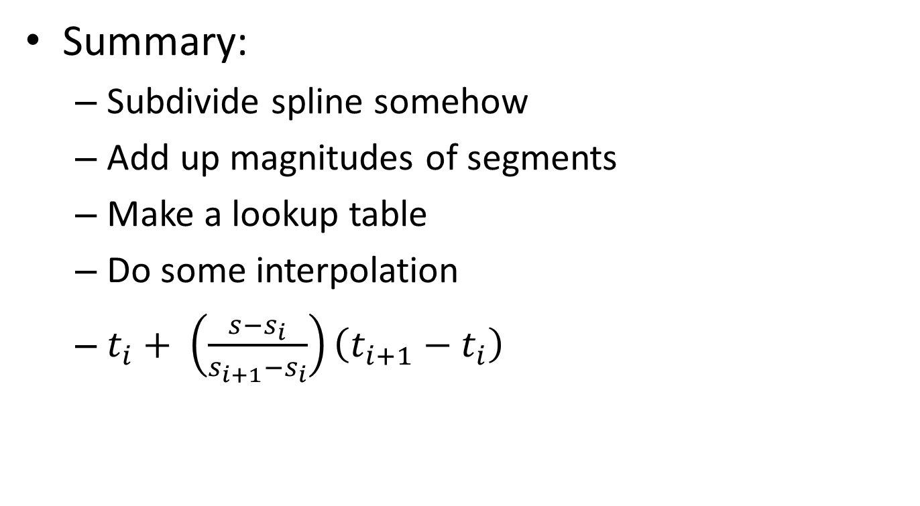
Chalk – details of arc length parameterization
Summary:
Subdivide spline somehow
Add up magnitudes of segments
Make a lookup table
Do some interpolation
$t_{i}+ \left(\frac{s−s_{i}}{s_{i+1}−s_{i}}\right)\left(t_{i+1}−t_{i}\right)$

Slide 14
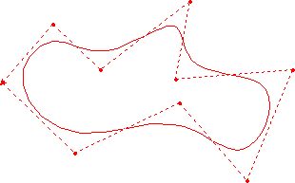
Bsplines
Given p1,…pn, define a curve that approximates the curve.
If b_{i}(t) is very smooth, so will be f
If b_{i}(t) has local support, f will have local control

Slide 15
Uniform Linear B-splines
b₁(t)
b₂(t)
b₃(t)
p₁
p_{n}
p₂
Notes:
Show why is so in each dimension?

Slide 16
How can we make the curve smooth?
Box(t)
Convolution/filtering
1
0
1
t

Slide 17
Uniform Quadratic B-splines

Slide 18
Uniform Cubic Bspline

Slide 19
Uniform B-splines
Why smoother?
Linear = box filter ⊗ box filter
Quadric = linear ⊗ box filter
Cubic = quadric ⊗ box filter
Sum = 1 property, translation invariant
Local control
C(k-2) continuity

Slide 20
Chalk – De Boor / Cox

